Slide 1
BREXIT CONFERENCE
FOR REGIONAL BUSINESS LEADERS

Slide 2
CHAIR’S WELCOME
Robert Capper
Partner, Head of Commercial Team and Sectors

Slide 3
THE VIEW FROM…
Richard Butler
Regional Director, CBI West Midlands

Slide 4
THE VIEW FROM…
Ian Mean
Main Board Member, GFirst LEP
Director, Business West in Gloucestershire

Slide 5

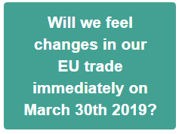
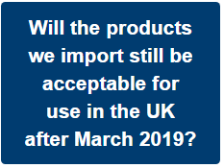
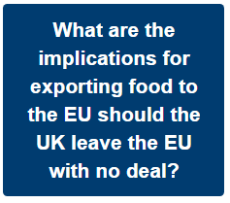
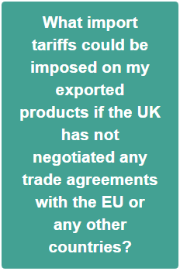
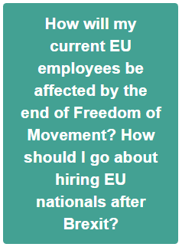
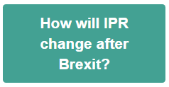
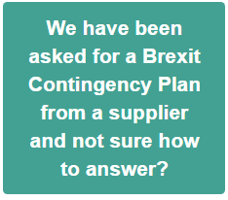
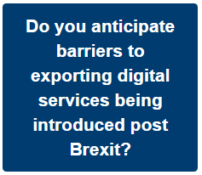
Your Questions Answered
https://www.businesswest.co.uk/campaigns/trading-through-brexit/your-brexit-questions-answered

Slide 6
THE VIEW FROM…
Gary Woodman
Chief Executive, Worcestershire Local Enterprise Partnership

Slide 7
Boosting local productivity
Strategic objective to increase Worcestershire’s Gross Value Added (GVA) by £2.9bn
Worcestershire LEP invests in boosting productivity with £71.71m Growth Deal and €68m EU Programme
Worcestershire LEP also works with partners to secure additional funding including £54.5m for dualling Carrington Bridge and £4.8m for Worcestershire’s 5G Testbed
Notes:
If interested in any business support, including signposting to services that can help with cyber security – contact Worcestershire Business Central
If from outside the region and interested in a future in the County – can speak to Gary Woodman today or contact the Invest in Worcestershire Team.

Slide 8
Infrastructure
Digital and physical infrastructure are vital
94% of county’s businesses and residents now have access to Superfast Worcestershire broadband
£67m Gigabit Broadband Voucher Scheme contributes £3,000 to installation cost of gigabit connection for small businesses
WLEP has also invested in transport infrastructure like Hoobrook Link Road, Southern Link Road, Kidderminster Railway Station and Worcestershire Parkway Station.
Notes:
If interested in any business support, including signposting to services that can help with cyber security – contact Worcestershire Business Central
If from outside the region and interested in a future in the County – can speak to Gary Woodman today or contact the Invest in Worcestershire Team.

Slide 9
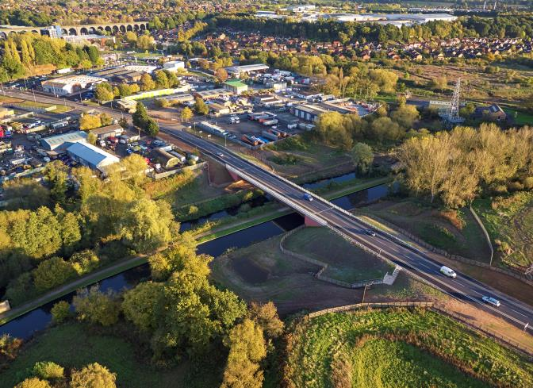
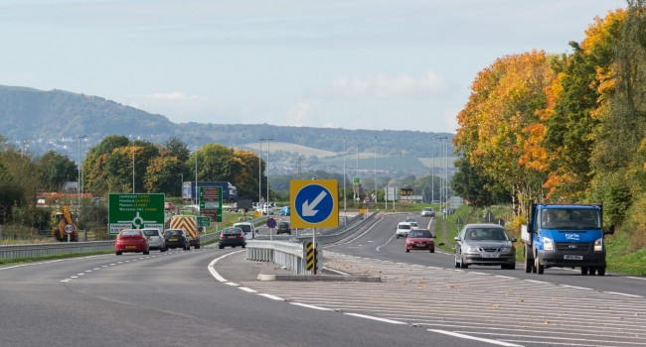
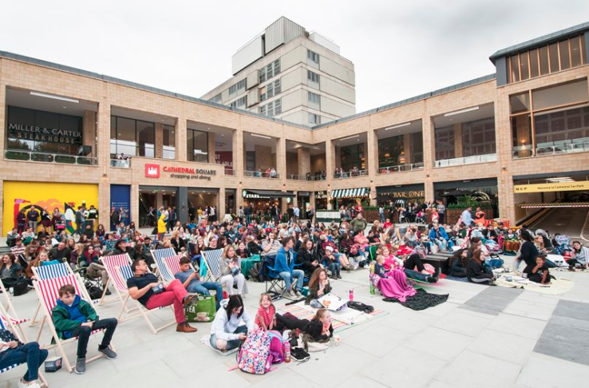
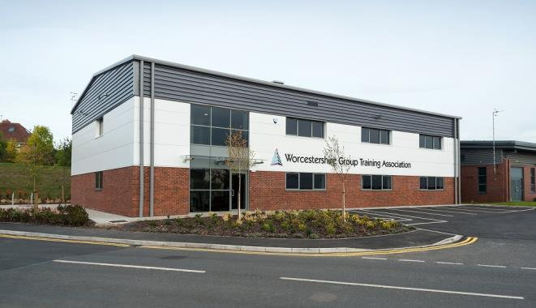
Completed Schemes
Hoobrook Link Road
Southern Link Road
Cathedral Square
Centre of Vocational Excellence

Slide 10
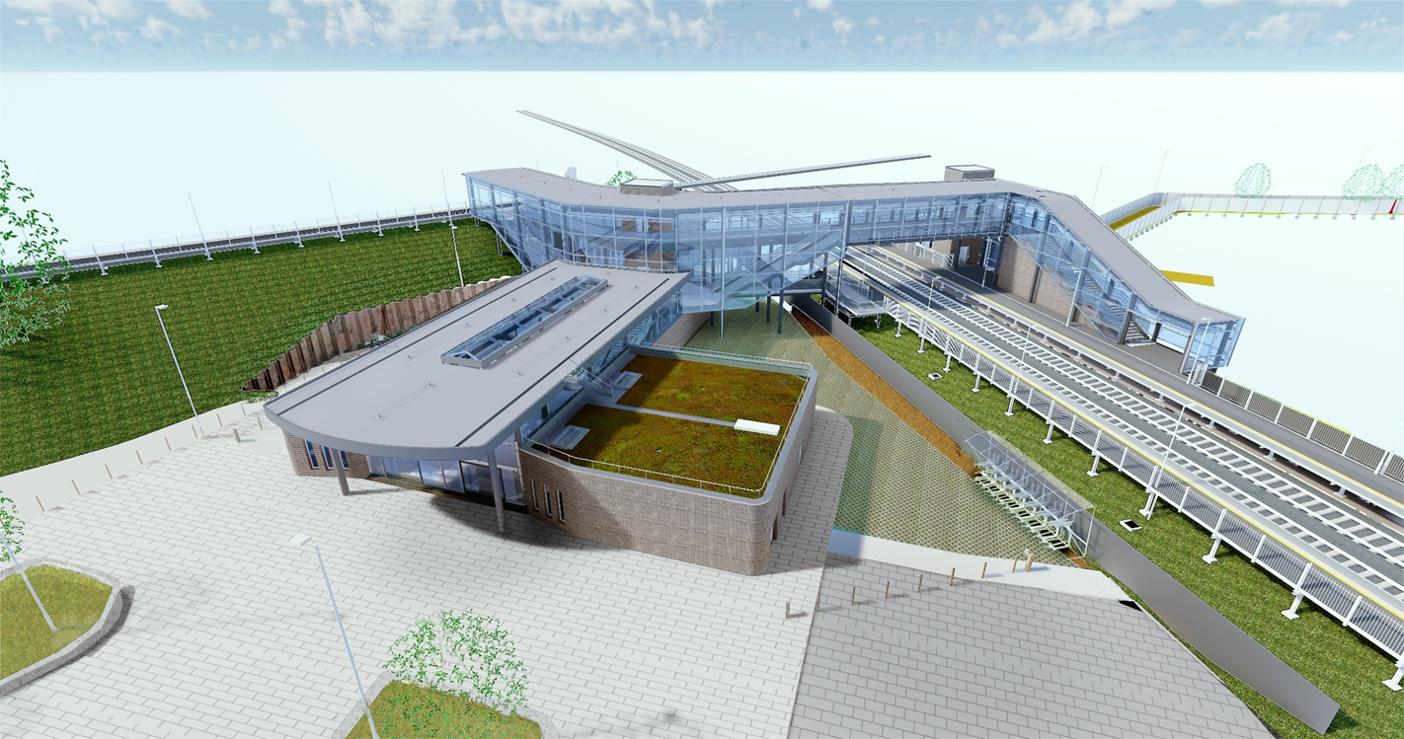

Further Investments
Our skills network is helping to
create our future workforce
Developing future employees
with the skills to be productive
Worcestershire has one of 20 Careers Hubs in England
Worcestershire had the largest growth in higher level workforce skills of all LEP areas in England, between 2010-2015.
Notes:
If interested in any business support, including signposting to services that can help with cyber security – contact Worcestershire Business Central
If from outside the region and interested in a future in the County – can speak to Gary Woodman today or contact the Invest in Worcestershire Team.

Slide 11
Creating our future workforce
Our skills network is helping to
create our future workforce
Developing future employees
with the skills to be productive
Worcestershire has one of 20 Careers Hubs in England
Worcestershire had the largest growth in higher level workforce skills of all LEP areas in England, between 2010-2015.
Notes:
If interested in any business support, including signposting to services that can help with cyber security – contact Worcestershire Business Central
If from outside the region and interested in a future in the County – can speak to Gary Woodman today or contact the Invest in Worcestershire Team.

Slide 12
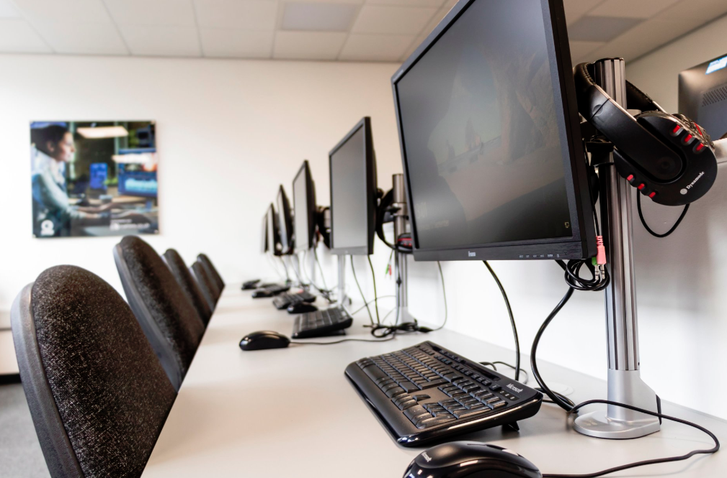

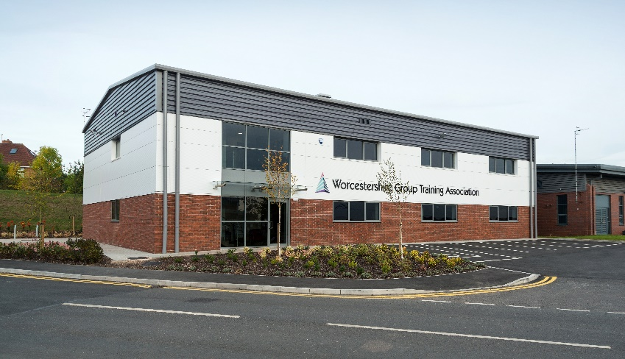
Modern places to learn
Worcestershire LEP has invested in modern educational facilities:
HoW College’s ‘Centre of Digital Engineering’ (CODE)
North Worcestershire Engineering Centre of Excellence
Centre of Vocational Excellence
Evesham Engineering Centre
Pershore College
Notes:
If interested in any business support, including signposting to services that can help with cyber security – contact Worcestershire Business Central
If from outside the region and interested in a future in the County – can speak to Gary Woodman today or contact the Invest in Worcestershire Team.

Slide 13
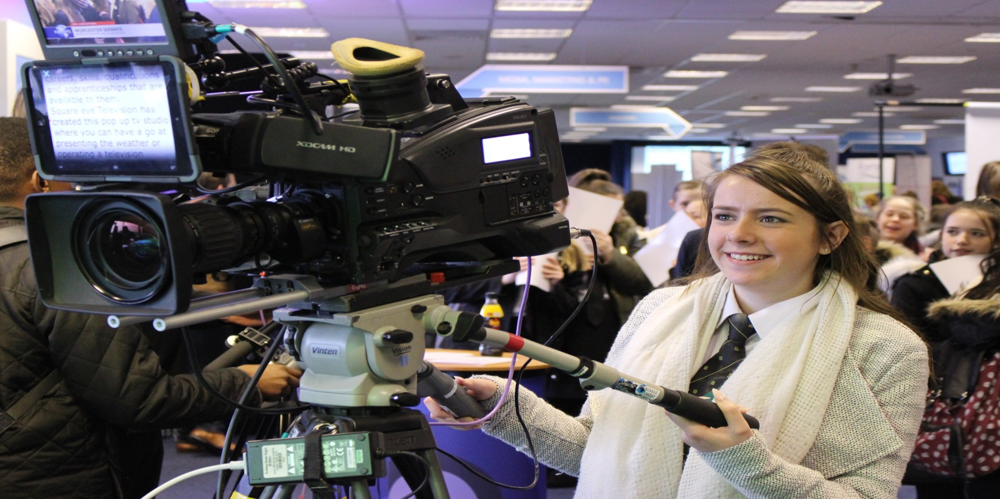

Our People

Slide 14
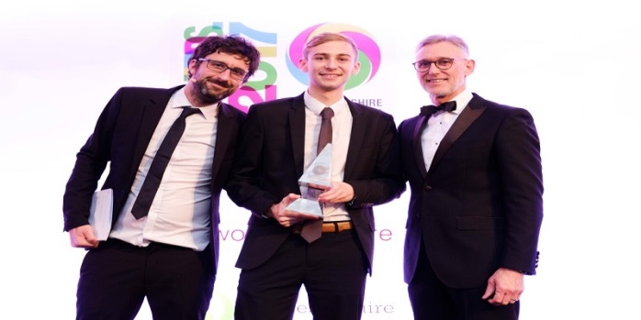
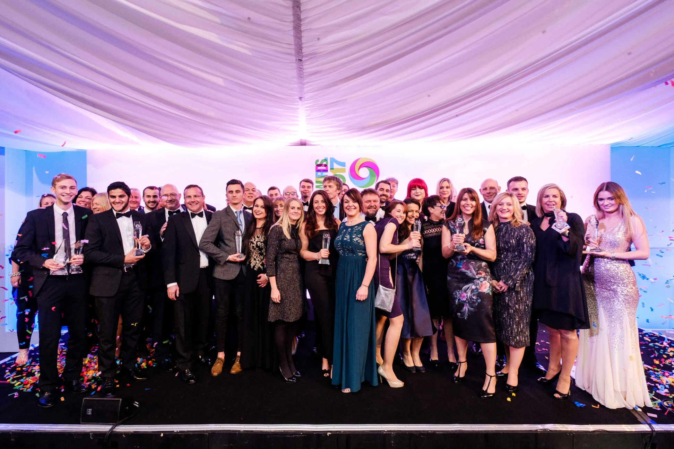

Our People

Slide 15

Notes:
If interested in any business support, including signposting to services that can help with cyber security – contact Worcestershire Business Central
If from outside the region and interested in a future in the County – can speak to Gary Woodman today or contact the Invest in Worcestershire Team.

Slide 16

Notes:
If interested in any business support, including signposting to services that can help with cyber security – contact Worcestershire Business Central
If from outside the region and interested in a future in the County – can speak to Gary Woodman today or contact the Invest in Worcestershire Team.

Slide 17

Worcestershire 5G Consortium
The Worcestershire 5G Testbed is leading the charge in pioneering industry 4.0 to create a connected, creative and dynamic economy for businesses and investors.
“The Worcestershire 5G Consortium is leading the way for UK digital transformation, using the huge opportunity 5G presents to enhance advanced manufacturing output on a national scale.”
Prof Rahim Tafazolli, Director of the 5GIC
Notes:
If interested in any business support, including signposting to services that can help with cyber security – contact Worcestershire Business Central
If from outside the region and interested in a future in the County – can speak to Gary Woodman today or contact the Invest in Worcestershire Team.

Slide 18









Worcestershire 5G Consortium
Early research is showing that 5G can improve productivity by as much as 1%
Drawing in collaboration from across the globe including recent delegation visit from Taiwan
Shortlisted for the World Communication Awards
World-renowned brands involved in the consortium:

Slide 19



Entrepreneurialism
Boosting the country’s entrepreneurialism is an important part to growing productivity
Schemes such as BetaDen, The Kiln and WINN (Worcestershire Innovation) all help to strengthen the county’s entrepreneurial ecosystem
Newly launched BetaDen is allowing tech start ups to draw upon 5G expertise and coaching from specialist mentors with wide ranging knowledge specific to tech companies
Notes:
If interested in any business support, including signposting to services that can help with cyber security – contact Worcestershire Business Central
If from outside the region and interested in a future in the County – can speak to Gary Woodman today or contact the Invest in Worcestershire Team.

Slide 20

Find out more…
Visit Worcestershire LEP’s website: www.wlep.co.uk
Notes:
If interested in any business support, including signposting to services that can help with cyber security – contact Worcestershire Business Central
If from outside the region and interested in a future in the County – can speak to Gary Woodman today or contact the Invest in Worcestershire Team.

Slide 21
THE VIEW FROM…
Frank Myers
Chair, Herefordshire Business Board
Board Member, The Marches LEP

Slide 22
PANEL Q&A

Slide 23
ROUND TABLE DISCUSSION
Discuss, debate and share views on the challenges and opportunities you anticipate or have experienced in relation to Brexit

Slide 24
KEYNOTE:
MANAGING THE DISRUPTION TO YOUR MARKETS
Nicolas Groffman
Partner, Head of International Team

Slide 25

The problem
World Bank has trimmed its growth forecast for the UK
Netherlands: recruiting nearly 1,000 customs officials to prepare for a surge in post-Brexit bureaucracy
The European Commission: no certainty that an agreement will be reached
The Office for National Statistics: UK companies cut their investments in Britain amid mounting uncertainty over Brexit
Ford Motors: will take “whatever action is needed” to protect its business. They suffered a £760m drop in its European earnings in 2017
Microsoft: high import tariffs could see the company build its data centres elsewhere in Europe
Huawei: will spend a further £3 billion on procurement in Britain

Slide 26

Reality check
EU is 8% of world population
EU is 15% of world GDP
Both percentages are shrinking each year

Slide 27

What you need to check
Intellectual property
Build corporate customs infrastructure
Consider employees’ nationalities
Obtain Authorised Economic Operator status “trusted traders”
Make a plan B
Decide whether to make use of an EU free-trade agreement
Ensure cash flow for VAT and additional inventory
Check international contracts
Review supply chains

Slide 28

Top take-aways
Engage with reality
Do not choose path of least resistance
Know what you’re good at
Know when you need help

Slide 29

Questions?

Slide 30
KEYNOTE:
MANAGING THE DISRUPTION TO YOUR PEOPLE
Bev Smith
Partner, Head of Employment and Immigration

Slide 31

Brexit – Employment
Current position
Consequences of no deal?
How can you prepare for the future?

Slide 32

Brexit – Immigration
Current position
Consequences of no deal?
MAC report – what will the future look like?
How can you prepare for the future?

Slide 33
Questions?

Slide 34
CHAIR’S REMARKS
Robert Capper
Partner, Head of Commercial Team and Sectors

Slide 35
LUNCH

Slide 36
ASK AN EXPERT

Slide 37
BREXIT CONFERENCE
FOR REGIONAL BUSINESS LEADERS

